Slide 1
ATFの将来計画(from JFY2013)
提案書を５月末までに提出する予定。
ガイドラインに関するATF国際協力メンバーの合意を３月末までに得る。
現状での将来計画構想を報告する。
浦川順治
2011.1.25 at KEK

Slide 2
ATFがJFY2012中に達成するべき項目（将来計画の前提条件）
1.3GeV Linear Accelerator (ATF Linac) :
Upto 6.5Hz beam operation, 60mA/pulse multi-bunch beam injection
or more
Stable 100% injection efficiency
1.3GeV DR (ATF DR) :
200mA beam storage operation with 3 train (リングの真空レベルを
徹底的に改善するべし)
1 or 2pm vertical emittance
Stable 3 bunches/train extraction
Stable single bunch extraction with reputation rate 6.5Hz
Beam orbit stability less than a few microns vertically
ATF2 beam line:
Demonstration of 37nm beam focusing at IP
Beam orbit stability within ~10nm by FONT at IP

Slide 3
Guideline of research programs for ATF international collaboration
After 2012, it is expected that ATF will need to be motivated not only
by linear colliders, but also by other science. Moreover, the funding
for linear collider R&D at KEK will probably not be enough to fully
support ATF operation as now. Global international collaboration is
much desired. The extension of ATF/ATF2 beyond 2012, together with
STF, and the new organization for these projects is part of KEK’s
“pre-ILC plan”.
Following is rough guideline as the consensus of KEK ATF team and
ILC group.
R&D contribution to LC ~70%,
Application of advanced accelerator technologies to another field ~30%

Slide 4
High quality scientific proposals can be expected to mitigate future
funding problems and influence discussions of other changes. Two
funding contracts were applied for by KEK, to the MEXT (Non-linear
QED physics ) and to the JSPS (THz table-top FEL). If approved, major
resources for new proposals will be provided for new equipment and
upgrading of the ATF facility during 2011-2015, including also
contributions to continue ATF operation.
Approval process; first submit the draft to 11th TB meeting, second
modify it according to TB comments, then submit the modified
proposal to 6th ICB in March 2011. After that, we have to submit final
proposal to KEK directorates in May 2011. The approval process at KEK
will take several months, finally KEK directorates will give us their
conclusion to ATF International collaboration team.

Slide 5
Beam parameters (Interesting New parameters)
 | Nominal RDR | SB2009 | RDR Low charge | New low charge
E_{cm} (GeV) | 500 | 500 | 500 | 500
Ne | 2×10¹⁰ | 2×10¹⁰ | 1.0×10¹⁰ | 1.0×10¹⁰
F_{rep} (Hz) | 5 | 5 | 5 | 5
N_{b} | 2625 | 1320 | 5640 | 2625
P_{b} (MW) | 10.5 | 5.3 | 11.3 | 5.37
β_{x} (mm) | 20 | 11 | 12 | 8
β_{y} (μm) | 400 | 200 | 200 | 166
γε_{x} (μm) | 10 | 10 | 10 | 10
γε_{y} (nm) | 40 | 36 | 30 | 10
σ_{x} (nm) | 639 | 474 | 495 | 404
σ_{y} (nm) | 5.7 | 3.8 | 3.5 | 2.0
σ_{z} (μm) | 300 | 300 | 150 | 166
δ_{B} | 0.031 | 0.056 | 0.026 | 0.0241
n_{γ} | 1.3 | 1.74 | 0.832 | 1.01
Dy | 19.0 | 38.4 | 10.0 | 24.0
H_{D} | 1.74 | 1.63? | 1.56 | 1.6
θ (rad) | 0.00036 | 0.00048 | 0.00023 | 0.00029
N_{had} | 1.1 | 3.6 | 0.21 | 0.66
Trav. focus | No | Yes | No | No
L₀ (cm⁻²s⁻¹) | 2.0×10³⁴ | 1.9×10³⁴ | 2.0×10³⁴ | 2.0×10³⁴

Slide 6
1. Super-FQ R&D to make smaller beam size (less than ~20nm).
Demonstration of compact final focus & BDS tuning
are critical issues for CLIC and ILC and
ATF2 experience invaluable
2. Nano beam orbit control (Font study extension). in-kind contribution /3 years (2013-2015)

Slide 7
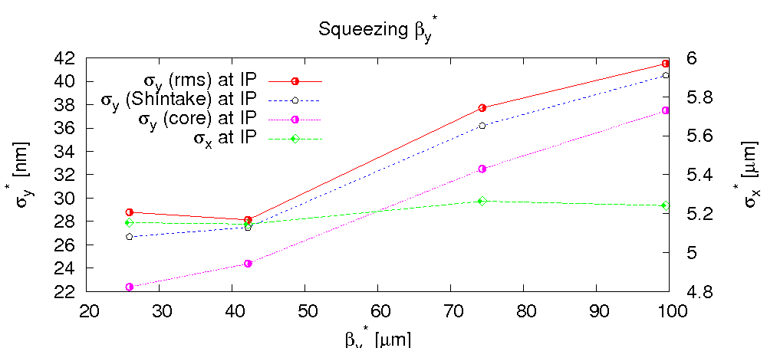
Ultra-low beta-function
R. Tomas
motivation
To prove CLIC chromaticity levels in ATF2 requires a factor 4 lower IP beta function. The main obstacle is the field quality (already issue for ATF2 nominal)
project | L*[m] | β_{y}* [μm] | ξ_{y}
ATF2 nominal | 1.0 | 100 | ~19000
ILC design | 3.5 | 400 | ~15000
ATF2 ultra-low | 1 | 25 | ~76000
CLIC 3 TeV | 3.5 | 90 | ~63000
limitation from multipoles: σ_{y}* vs β_{y}*
with measured magnetic multipoles; optimization with MAPCLASS; no further reduction when decreasing β_{y}* below 40 μm
β_{x}*=10 mm

Slide 8
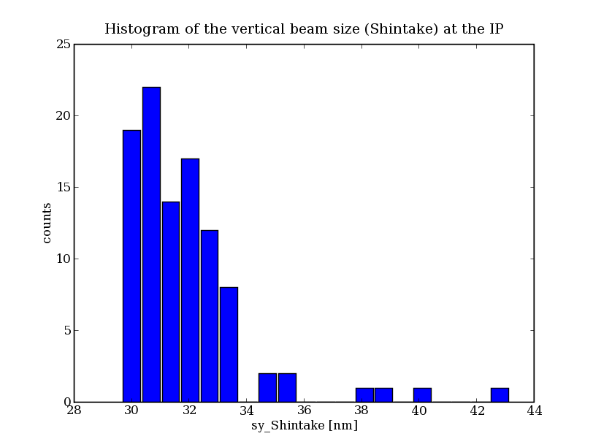
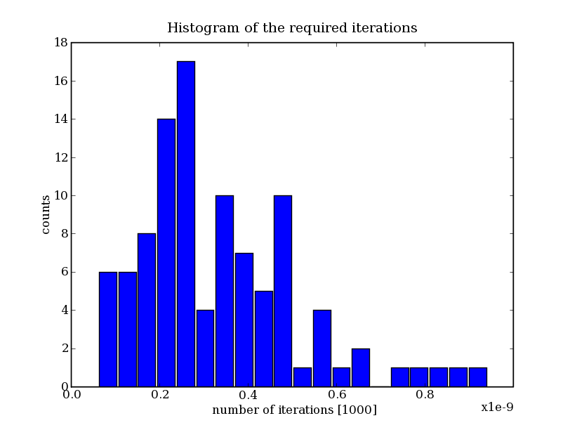
Ultra-low beta-function cont’d
R. Tomas,
E. Marin
tuning ATF2 ultra-low β_{y}
β_{y}*=40 μm; β_{x}*=10 mm
90% seeds reached a σ_{y}* < 34 nm
Tuning based on an iterative application of knobs. All seeds converge below 1000 iterations.
all elements misaligned and tuning knobs applied; beam sizes after tuning not as good as design; work in progress to improve further

Slide 9
Ultra-low beta-function cont’d
ways to reach β_{y}*=25μm
E. Marin, D. Schulte, R. Tomas
Replacing QF1 with a superconducting quadrupole
(B. Parker) removes most of the harming nonlinearities;
if SC Q1 does not become available, CLIC considers
building better-quality warm Q1(2) magnets for ATF2(3)
Reducing DR horizontal emittance (SC wigglers)
CLIC considers contributing new high-field low-period
Nb₃Sn wiggler (~15-20% emittance reduction)
New non-linear corrector magnets in ATF2 beam line
CLIC could also provide such elements (instead of or in
addition to Q1(2))

Slide 10
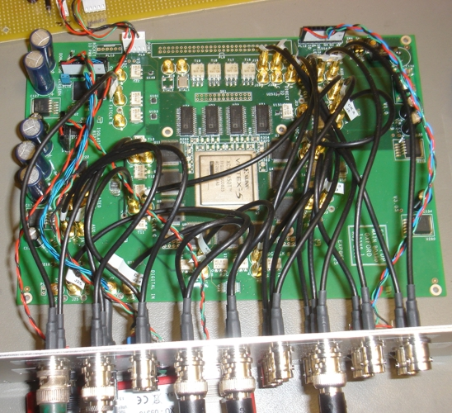
FONT5 digital FB board
Xilinx Virtex5 FPGA
9 ADC input channels
(TI ADS5474)
4 DAC output channels
(AD9744)
Clocked at 357 MHz
phase-locked to beam
4x faster than FONT4

Slide 11
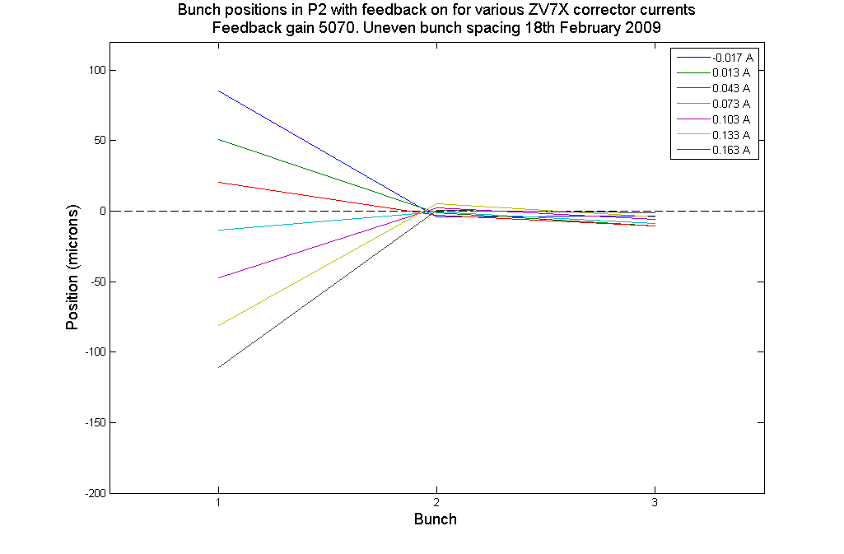
P2 → K1 loop performance
Incoming position scan

Slide 12
P2 → K1 loop jitter reduction
Bunch 1 Bunch 2
2.1 um → 0.4 um
Factor of 5 jitter reduction

Slide 13
3. Gamma-Gamma laser system R&D. (2013-2017)
(Gamma-gamma collider R&D)

Slide 14
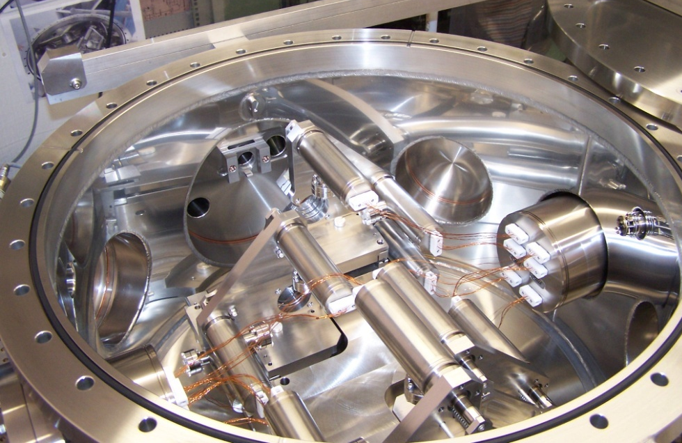
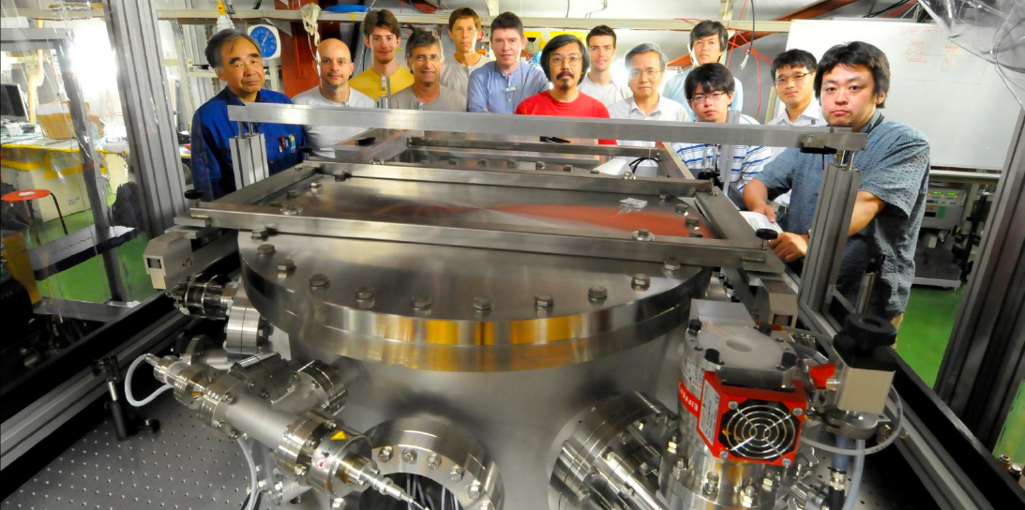
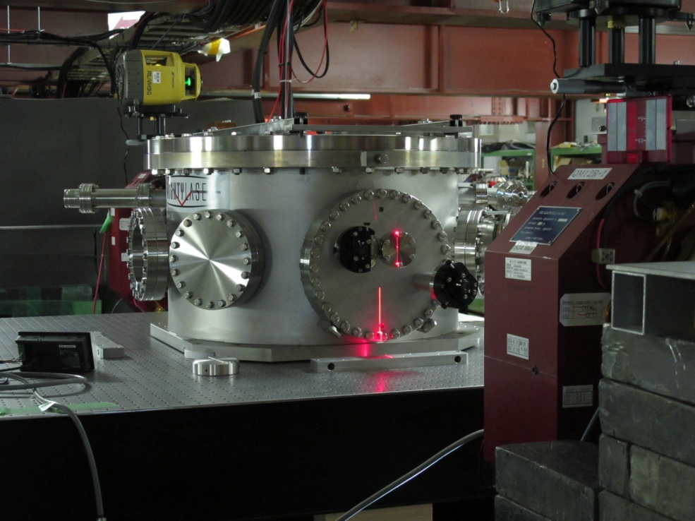
(1) French 4 Mirror Cavity installed in ATF:
4-mirror cavity has a potential to get a smaller spot
4 Mirror Cavity at LAL
Happy People
2010 Works
• July-Aug Cavity installed in ATF
French Team (9 persons) at KEK
Cavity installed in ATF
• Aug/30th Laser locked to Cavity
• Sep/24th Cavity locked to ATF
• Oct/25th 1st gamma observed
• Nov/1st Laser trouble -> sent to Zurich
• Dec/12th Gamma observed again
2011 Schedule
• Feb-May Running and improvements
• Summer Major improvements to
ultimate enhancement

Slide 15
4. CLIC related issues
Test of hybrid final-quadrupole solution for CLIC at ATF (small aperture), e.g. close to IP;
interesting if a place can be found and if the spot size could be significantly reduced.
Correction of magnet motion with sensor and feedback on the beam could be tested at ATF;
sensors still need to be optimized for frequency range of interest; ATF frequency is not
optimum but could be increased to 12.5 or at least 6 Hz. A fast kicker is used for 30 bunch
extraction, spaced 150 ns. The ultimate ATF repetition rate limit is 12.5 Hz, which would start
to be interesting for CLIC tests. Reaching 12.5 Hz would need modifications of the laser system
(6 Hz possible), and perhaps of cooling system, of kickers, etc…. The RF system already runs
at 12 Hz. 6 Hz is more easily possible. Geophones exist at CERN which are sensitive at 6 Hz,
though this is different from the future CLIC frequency.
Double kicker system? Any need for improvement of double kicker system. Several 1x10⁻⁴
stability of pulsed fast kicker achieved recently. This is comparable to the double kicker
which accomplished 3x10⁻⁴ stability. The stable operation of the single fast kicker is present
ATF objective.
Damping ring. Goal to reduce vertical emittance to 1 pm using precise correction of orbit
and coupling. Extract vertical emittance beam stably, and reduce emittance growth in
extraction line. A prototype CLIC DR wiggler could be installed in the ATF DR to lower
the emittance.
CLIC would like (to continue) to work on ATF and transfer line tuning, including tuning of
the damping ring. There is always the need for tuning the ring in order to maintain a small
emittance. Feedback system can help for stabilization, e.g. orbit feedback.

Slide 16
proposed future CLIC contributions
Ultra-low beta-function
Limited by QF1, CLIC considers providing one with larger aperture
Ground motion feedback/feed-forward
Ground motion sensors on each relevant magnet to predict beam orbit
Test of quadrupole stabilisation in ATF extraction
Could be best way to verify stabilisation performance with beam
Developing damping ring extraction kickers systems
Would need ATF3 to verify kicker performance
CSR induced beam instability in ATF-DR
Experiments to distinguish between theories
DR optics, emittance tuning & IBS studies
Superconducting wiggler for ATF
BPM tests
CLIC main linac BPMs developed by FNAL tested at ATF2; more in future
Contributions to ATF2/3 operation

Slide 17
5) CSR induced beam instability in ATF-DR
theoretical approaches / references
F. Zimmermann
[1] G. Stupakov and S. Heifets, “Beam Instability and Microbunching due to Coherent Synchrotron Radiation,” PRST-AB 5, 054402 (2002); http://prst-ab.aps.org/pdf/PRSTAB/v5/i5/e054402
[2] S. Heifets and G. Stupakov, “Single-mode Coherent Synchrotron Radiation Instability,” PRST-AB 6, 064401 (2003); http://prst-ab.aps.org/pdf/PRSTAB/v6/i6/e064401
[3] K.L.F. Bane, Y. Cai, G. Stupakov, “Comparison of Simulation Codes for Microwave Instability in Bunched Beams,” Proc. IPAC’10, Kyoto Japan (2010) ; http://epaper.kek.jp/IPAC10/papers/tupd078.pdf
[4] D. Zhou et al, “CSR in the SuperKEKB Damping Ring,” IPAC’10 Kyoto (2010), http://epaper.kek.jp/IPAC10/papers/tupeb018.pdf
[5] F. Zimmermann, « Estimates of CSR Instability Thresholds for Various Storage Rings,” CERN ATS-Note-2010-049, CLIC-Note-861 (2010)

Slide 18
5) CSR induced beam instability in ATF-DR
ATF damping ring | nominal | lower energy
beam energy [GeV] | 1.28 | 1.00
slip factor η | 0.0019
rms momentum spread σ_{δ,rms} [%] | 0.06 | 0.047
bunch population [10⁹] | 10 | 10
circumference C [m] | 138.6
bending radius ρ [m] | 5.73
vert. beam pipe radius b [cm] | 1.2?
Stupakov-Heifets parameter Λ | 339 | 906
ρ/b | 478
σ_{z} [cm] | 0.5 | 0.39
ρ/(2 Λ^{3/2}) [cm] | 0.05 | 0.011
N_{b}r₀/( σ_{z}σ_{δ} γ) | 0.0015 | 0.0031
β_{x} at bend [m] | 3?
ε_{x} [nm] | ~1.5 | 0.9
σ_{x} at bend [μm] | 67 | 52
ρ^{4/3}/(σ_{x}β_{x})^{2/3} | 2990 | 3540
τ_{x} [ms] | 17.2 | 36.1
Q_{s} | -0.0045
 | 1.15x10¹⁰ | 4.3x10⁹
 | 0.86 | 2.32
Λb/ρ | 0.71 | 1.90

Slide 19
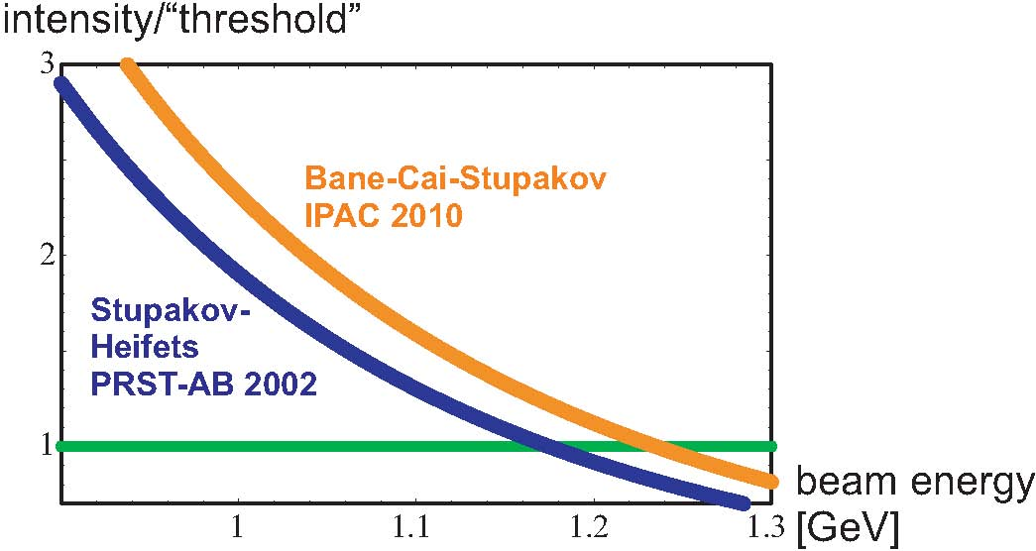
5) CSR induced beam instability in ATF-DR
lowering ATF beam energy → CSR instability
bunch intensity 10¹⁰
fully coupled
to suppress IBS?
Note: Bane-Cai-Stupakov predict instability in a regime where it is excluded by Stupakov-Heifets
Also note: ATF Damping Ring has initially operated at 0.96 GeV beam energy, in 1997

Slide 20
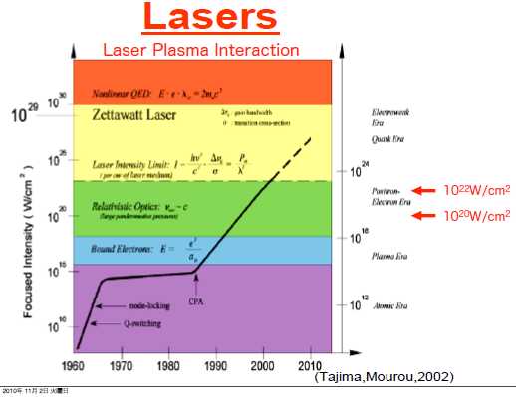
5. Non linear QED Physics (from high field physics to Vacuum science).
Need 10Hz, 200TW laser at ATF2, high-field physics at ATF2

Slide 23
6. Using 200TW laser, we will study to generate 10Hz, 10fsec,
300pC and 1.5GeV electron beam generation stability, then study
high field acceleration of 10fsec beam. (2013 to 2017)

Slide 24
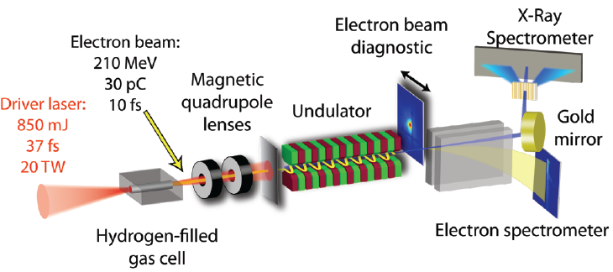
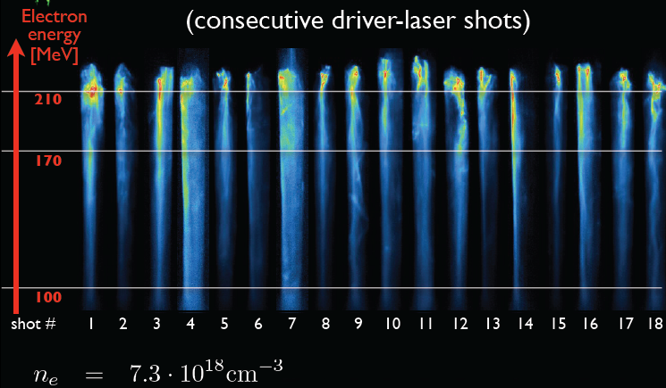

Slide 26
7. Beam acceleration by THz microwave
Overall the scope of ATF-2 will be significantly
widened with above new research items.
1. Super-FQ R&D to make smaller beam size (less than ~20nm).
2. Nano beam orbit control (Font study extension). in-kind
contribution /3 years (2013-2015)
3. Gamma-Gamma laser system R&D. (2013-2017)
(Gamma-gamma collider R&D)
4. CLIC related issues
5. Non linear QED Physics (from high field physics to Vacuum science).
Need 10Hz, 200TW laser at ATF2, high-field physics at ATF2
6. Using 200TW laser, we will study to generate 10Hz, 10fsec,
300pC and 1.5GeV electron beam generation stability, then study
high field acceleration of 10fsec beam. (2013 to 2017)
7. Beam acceleration by THz microwave

